Slide 1

PDO – Access to naloxone in Bernalillo County
Bernalillo County Community health council
Opioid Accountability initiative
Sharz Weeks, MPH
Program Specialist
sharz.bcchc@outlook.com

Slide 2
Prevention
PREVENTION is the ultimate strategy to reduce the scourge of drug use and deaths. Initiatives to give kids a healthy start in life pay off in many ways, including reduced likelihood for later drug use. Other preventive strategies include information about drugs and their risks and reducing access to drugs. Reduction of criminal distribution of drugs, curbing excessive or otherwise inappropriate prescribing of painkillers, and proper disposal of unused drugs are other examples of preventive strategies.
Treatment
Opioid use disorder (OUD) is a treatable chronic disease. Treatment has several important components. Medication assisted treatment (MAT) in conjunction with behavioral health counseling and treatment is the basis of treatment that has been shown to be most effective in saving lives and restoring people to healthful, productive lives. Treatment capacity in terms of numbers of providers able and willing to provide MAT is limited. A major challenge and priority is to build treatment capacity in the county.
GOAL
Reduce number (or rate) of overdose deaths associated with opioid use in Bernalillo County
(
Harm Reduction (Access to Naloxone)
HARM REDUCTION means taking steps to reduce risks in persons with opioid use disorder (OUD). By far the most important for saving lives is the distribution and use of naloxone (Narcan®). Properly administered, naloxone can rapidly and safely reverse an otherwise fatal opioid overdose. A priority for the Opioid Accountability Initiative (OAI) is to increase the distribution of naloxone, trying to make it available where and when it is needed. While naloxone saves lives, It does nothing to treat OUD or otherwise change the situation of the opioid dependent victims. That is where the Treatment Pillar is crucial.
Law Enforcement/Criminal Justice
LAW ENFORCEMENT/CRIMINAL JUSTICE/ PUBLIC SAFETY are aspects of a world that engages many people who have opioid drug use behaviors often along with social circumstances that keep many trapped in that world and places them at particular risk of overdose deaths. The strategies that address them are in the first three pillars, especially access to naloxone and access to effective drug treatment along with mental health and social support services.

Slide 3
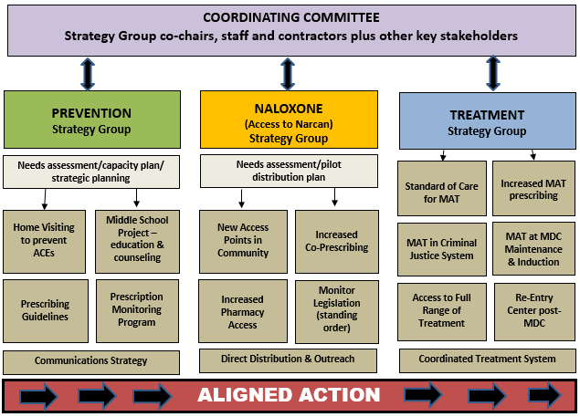

Slide 4

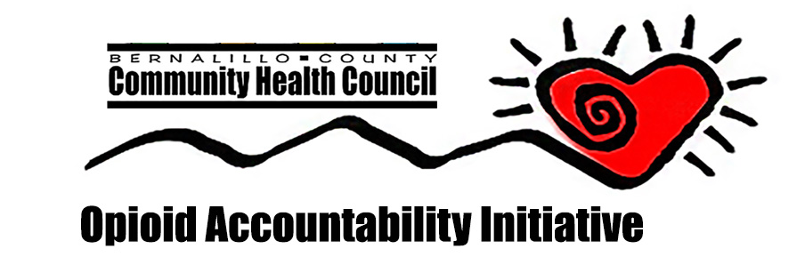
Our Coalition
The Naloxone Strategy Group
  One of the three strategy groups of the Opioid Accountability Initiative
  Naloxone distribution under PDO largest project
  Acts as guiding coalition for the naloxone distribution project
  Consists of pharmacists (commercial and research), AFD, APD, BCSO, City of Albuquerque/City Council, Bernalillo County, NM DOH, AHCH, MDC, others
  Brought information to help develop focus of plan for naloxone distribution
  Always open to new members

Slide 5
Epidemiology of Overdoses
NM drug overdose higher than national average
  8th highest in nation in 2015 (Peterson & Davis, 2017)
  Deaths tripled between 1990 and 2015 (Peterson & Davis, 2017)
NM Age-Adjusted Death Rate 2015
  24.8 deaths per 100,000 population
US Age-Adjusted Death Rate 2015
  16.3 deaths per 100,000 population

Slide 6
Epidemiology of Overdoses (cont.)
  2015 – 72.5% drug overdose deaths in NM involved opioids (Peterson & Davis, 2017)
  50.4% involved prescription opioids
  43.3% involved heroin
  6.3% involved both
Bernalillo has the highest number of overdose deaths – 937 (2011-2015) (NM-IBIS)

Slide 9
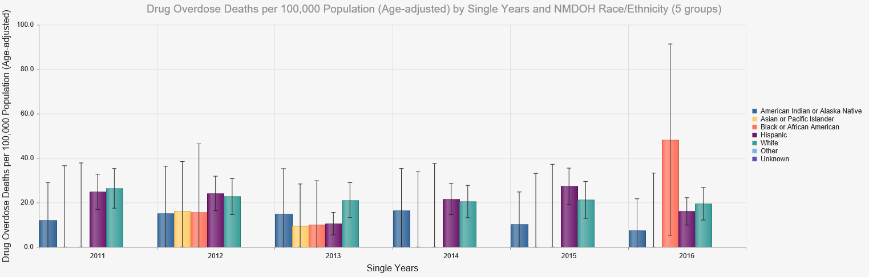
Female – Bernalillo County (2011-2016)

Slide 10
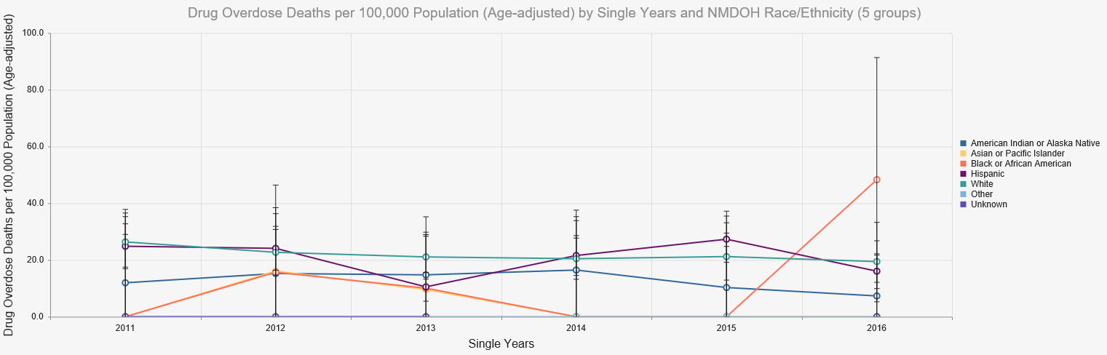
Female – Bernalillo County (2011-2016)

Slide 11
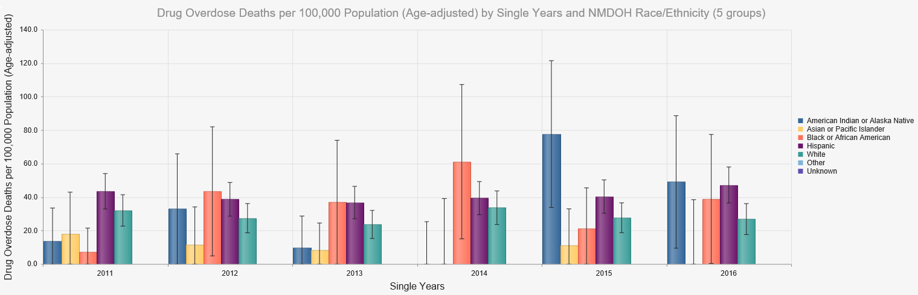
Male – Bernalillo County (2011-2016)

Slide 12
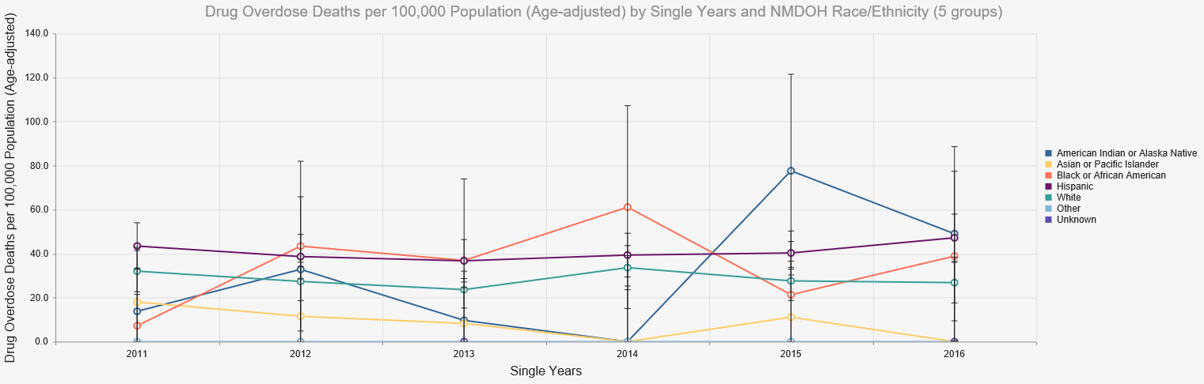
Male – Bernalillo County (2011-2016)

Slide 13
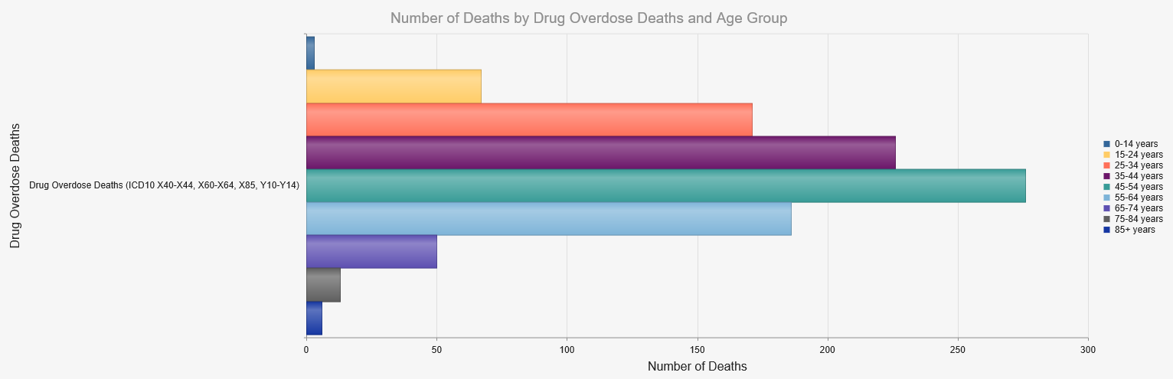
Female Overdose Deaths by Age Bernalillo County (2010-2014)

Slide 14
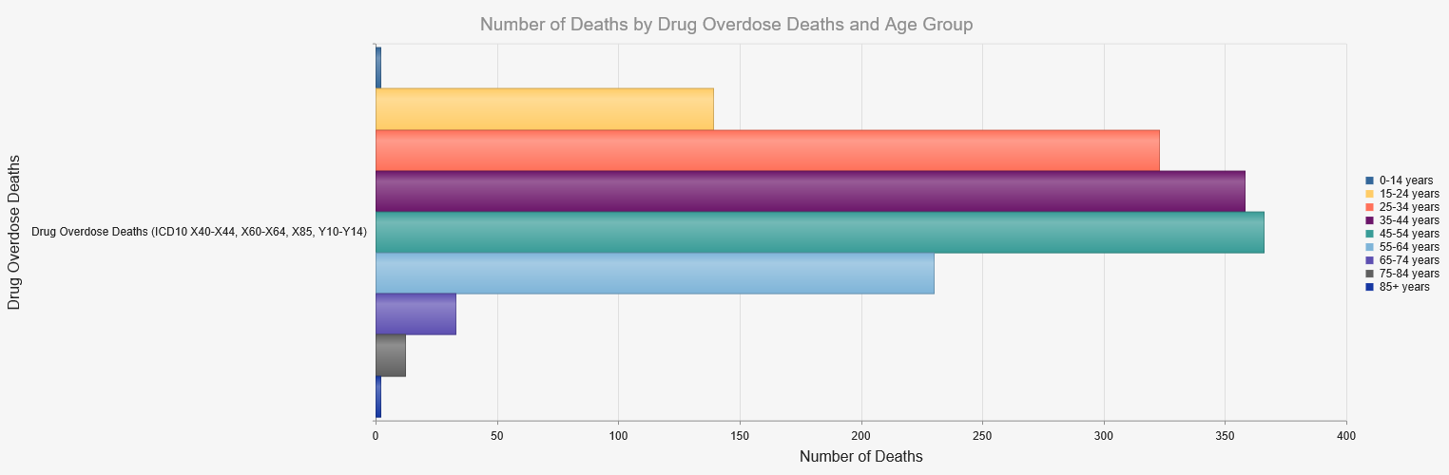
Male Overdose Deaths by Age Bernalillo County (2010-2014)

Slide 15
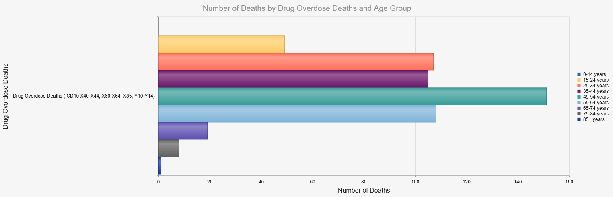
White Male Overdose Deaths by Age Bernalillo County (2010-2014)

Slide 16
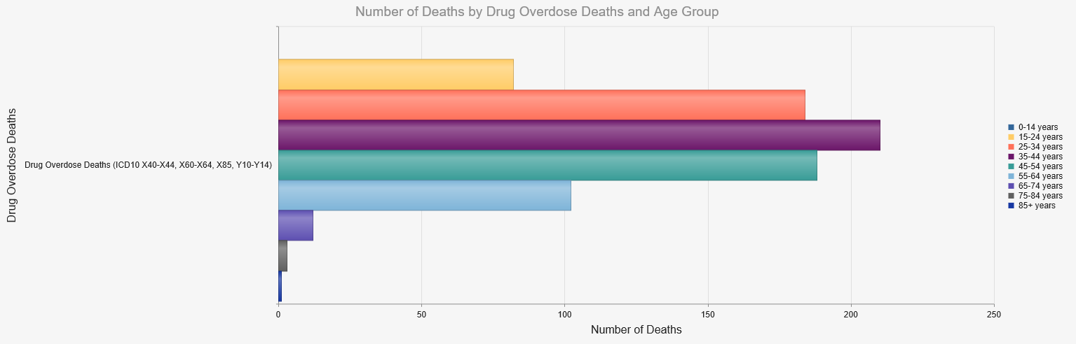
Hispanic Male Overdose Deaths by Age Bernalillo County (2010-2014)

Slide 17
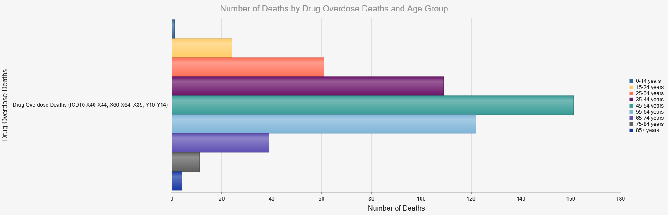
White Female Overdose Deaths by Age Bernalillo County (2010-2014)

Slide 18
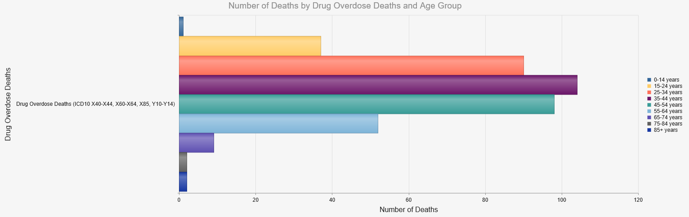
Hispanic Female Overdose Deaths by Age Bernalillo County (2010-2014)

Slide 19
2,268
917
617
43
81

Slide 20
67.1
65.5
54.1
37.4
47.1
56.6

Slide 21
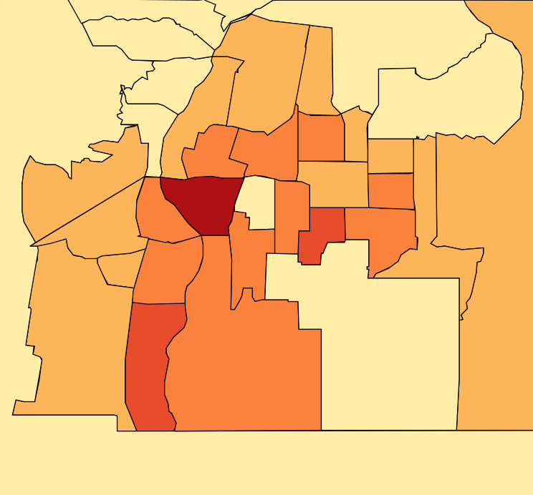
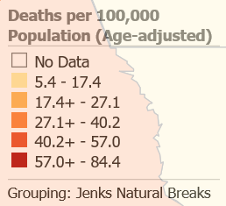
Bernalillo County Overdose Death Rates & Numbers by Small Area 2010-2014 (over the county average of 28.3 per 100,000)
19 – Candelaria Second
Rate: 40.2
# Deaths: 32
Pop: 86,798
20 – Comanche Carlisle
Rate: 35.2
# Deaths: 30
Pop: 88,023
8 – Lomas Broadway
Rate: 65.6
# Deaths: 69
Pop: 102,664
23 – Montgomery Louisiana
Rate: 33
# Deaths: 36
Pop: 109,192
15 – Central Coors
Rate: 37.9
# Deaths: 41
Pop: 113,222
22 – Indian School Juan Tabo
Rate: 30.6
# Deaths: 29
Pop: 100,179
4 – Lomas San Mateo
Rate: 31.4
# Deaths: 36
Pop: 103,049
14 – Arenal Tapia
Rate: 37.1
# Deaths: 36
Pop: 98,168
6 – Gibson University
Rate: 38.9
# Deaths: 26
Pop: 64,968
2 – Central Juan Tabo
Rate: 35.5
# Deaths: 55
Pop: 156,095
10 – Isleta Gun Club
Rate: 41.1
# Deaths: 27
Pop: 68,910
7 – Rio Bravo Second
Rate: 31.6
# Deaths: 15
Pop: 48,238
1 – Central Penn
Rate: 57
# Deaths: 77
Pop: 138,145

Slide 22
Programmatic activities – the needs assessment
Needs assessment conducted in February
  Three major hotspot areas for overdose deaths (IBIS, 2015)
    Downtown (69.5 deaths per 100,000 population)
    International District (53.6 deaths per 100,000 population)
    University South (47 deaths per 100,000 population)
  Identified South Valley as potential for expansion – 41.1 deaths 2010-2014 IBIS
  Identified potential routes for naloxone distribution not already being used

Slide 23
Programmatic activities – Distribution plan
Goal
  Distribute Narcan to non-traditional first responders – i.e.:
    To those not captured by other programs
    To those who would most likely be in a position to respond to an overdose
    To those in the social circle of people at risk of an overdose
    Individuals recently incarcerated
    Overdose survivors

Slide 24
Distribution plan
Populations targeted for naloxone distribution
  People who use opioids/heroin
  Layperson first responders
  Corrections Department
  Law Enforcement
  Hospital emergency Departments
  Fire Departments

Slide 25

Partner agencies
UNMH – Emergency Department
  Target Population: People Who Use Opioids/Heroin, Overdose Survivors, Lay First Responders
  Agency Focus: Naloxone distribution upon release from ED or immediately after
  Training Focus: Overdose prevention education & naloxone distribution – Nurses, Peer Support Workers, NM Poison and Drug Information Center staff.
  Training on providing education with strict time constraints
  Pilot focus on logistics and distribution after ER visit – focus on friends & family

Slide 26

Partner agencies
NMCD – Probation & Parole – Bernalillo County
  Target Population: Those Released from Incarceration, People Who Use Opioids/Heroin, Overdose Survivors, Lay First Responders
  Agency Focus: Naloxone distribution to probationers, parolees, & family/friends
  Training Focus: Overdose prevention education & naloxone distribution
  Pilot focus on small handful of Transitional Coordinators to train probationers and parolees

Slide 27
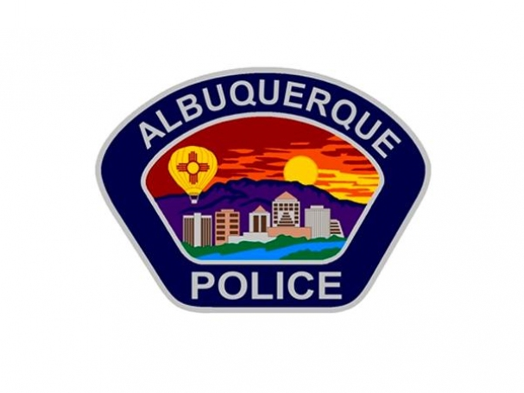
Partner agencies
Albuquerque Police Department
  Target Population: People Who Use Opioids/Heroin, Overdose Survivors, Lay First Responders
  Agency Focus: Naloxone distribution at the scene of an overdose; Naloxone administration in overdose response
  Training Focus: Overdose prevention education & naloxone distribution & naloxone administration
  Pilot focus on Downtown Squad

Slide 28

Partner agencies
Youth Development, Inc.
  Target Population: People Who Use Opioids/Heroin, Lay First Responders
  Agency Focus: Naloxone distribution to families & friends of clients
  Training Focus: Overdose prevention education & naloxone distribution
  Pilot focus on reaching parents & friends of participants within Casa Hermosa and Gang Intervention Program

Slide 29
BCCHC outreach
The Bernalillo County Community Health Council Direct Street Outreach
  BCCHC will utilize staff and volunteers to conduct direct street outreach of naloxone
  Focus
    Individuals who use opioids/heroin
    Family, friends, and those in social circles
    Downtown, International District
    People who are not accessing Syringe Exchange Services

Slide 30
Current progress
295 kits of Narcan distributed to partner agencies/public
8 total training sessions to date + outreach
All partner agencies have been trained and are distributing

Slide 31
Challenges
Agreements – bureaucracy
  Research vs evaluation in public health programs
Data collection
Timeframe
Move to Direct Service
Organization’s Stages of Change – how do we begin?

Slide 32
successes
APD – Carry and Distribute.
Training Community Partners
  Goodwill
  Community Health Worker Association
Permeation into Community – PDO as a catalyst
Recognizing challenges and adjusting accordingly - process evaluation type of development
Facilitating internal agency conversations/breaking down stigma

Slide 33
Pilot considerations
Pilot is a test phase
  We hope to gather data to determine future aims of the program
BCCHC will evaluate partner agencies during pilot to establish needs for implementation phase/continuance during implementation phase.
Notes:
Continuance is important because some agencies may not want to participate anymore.

Slide 34
Expansion/plans for the future
BCCHC continues to explore possibilities for expansion
  There are more hot spot areas that could be reached
  APD Expansion
  Presbyterian Hospital ER distribution
  Community agencies
  County Community Centers
BCCHC is available to train local organizations in overdose prevention and response. If you’re interested, feel free to contact me.

Slide 35
Questions?

Slide 36
If you would like to become involved in the Naloxone Strategy Group,
If you would like Overdose Prevention and Response training for you and your staff,
Or if you would like to discuss opportunities to incorporate naloxone outreach in your community,
Contact Sharz Weeks:
  sweeks@bchealthcouncil.org
  505-246-1638

